Slide 1
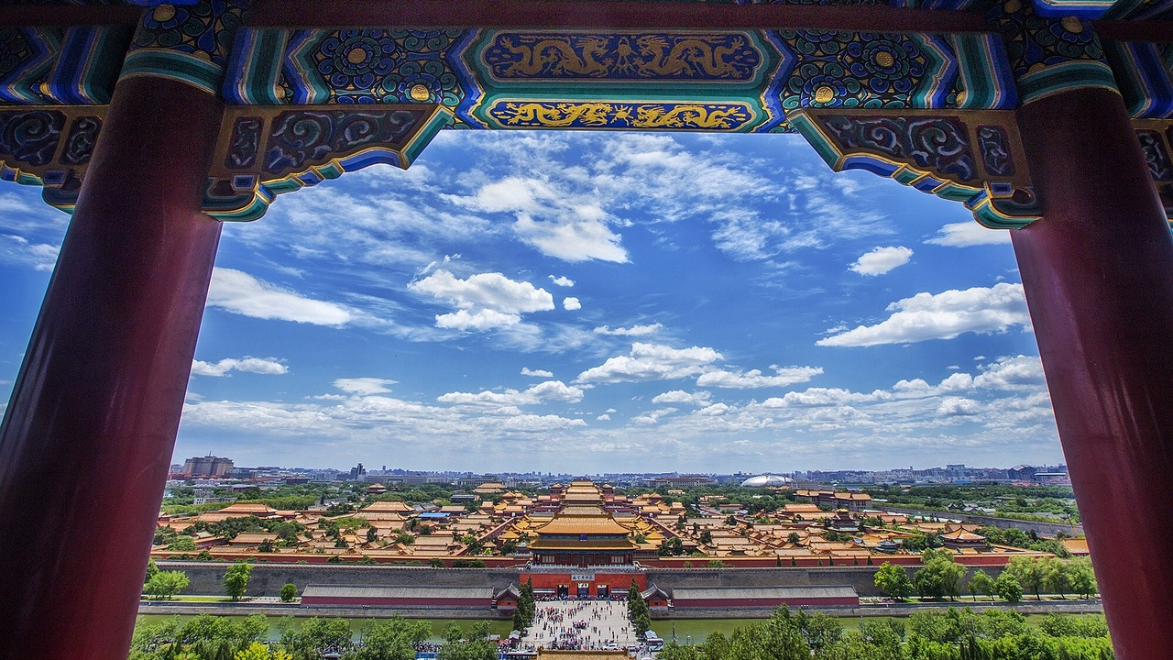
Auspicious Capital
Beijing 3N4D Package Tour

Slide 2
SCHEDULE
HANTANG TOUR
Temple of Heaven
After visiting the Temple of Heaven， transfer to airport for onward flight.
Great Wall &
DingLing Mausoleum
DAY 1
DAY 3
ARRIVAL
Arrive in Beijing.
Meet assist at the airport/railway station & transfer to the hotel for check-in.
DAY 2
Forbidden City&
Tiananmen Square&
Summer Palace
DAY4
DEPARTURE

Slide 3
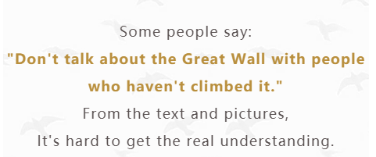
THE GREAT WALL
HANTANG TOUR
It is 7.8 meters high, 6.5 meters across at its base and 5.8m at its top. There is a watchtower rise to about 12 meters every one hundred meters.
"He who has never been to the Great Wall is not a true man".
The Great Wall was selected on the list of the World Heritage in 1987

Slide 4
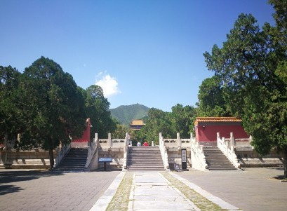
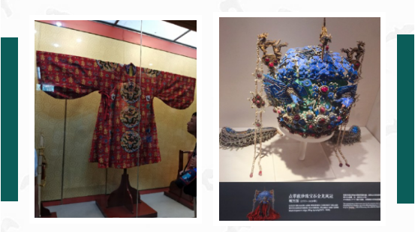
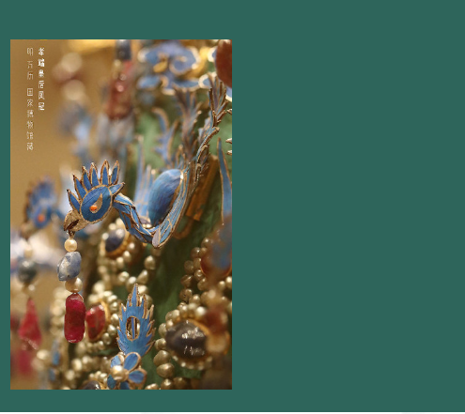
Dingling
​Mausoleum
of
Ming Dynasty
Established in
1584～1590
The Ming Tombs are located in the northwestern suburbs of Beijing, they are the tombs of 13 emperors of the Ming Dynasty, and Dingling Mausoleum is the tomb of the tenth emperor and his two empresses.
It consists of five chambers built of stone. Its total area is 1,195 ㎡. Two Side Chambers are 7.1 meters high each. In the Central Chamber there are three thrones. The Back Chamber, 9.5 metres high, is the place where the coffins are kept.
The grave goods of Dingling number over 3,000 pieces in all, including gold, silver, pearls, jewels, jadeware, chinaware, lacquerware, silk goods…
HANTANG TOUR

Slide 5
HANTANG TOUR
/Forbidden City
The imperial palace of the two dynasties in Ming and Qing Dynasties(1368-1911AD).
Located in the center of Beijing's central axis.
The cream of ancient Chinese palace architecture.
The Forbidden City is centered on three main halls, covering an area of 720,000 square meters, with a construction area of about 150,000 square meters. It has more than 70 palaces and more than 9,000 houses. It is one of the largest and most complete ancient wooden structures in the world.

Slide 6
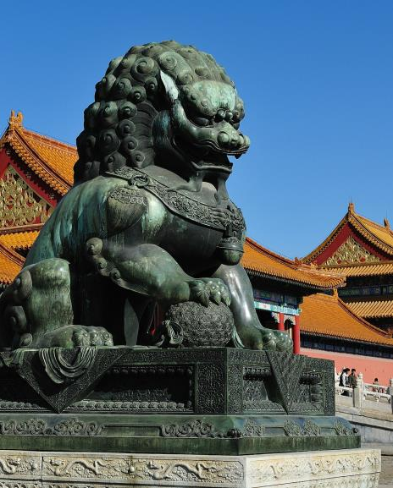
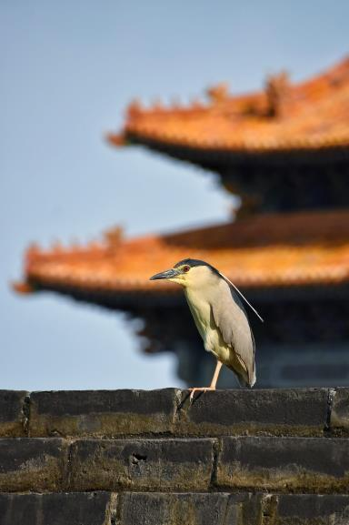
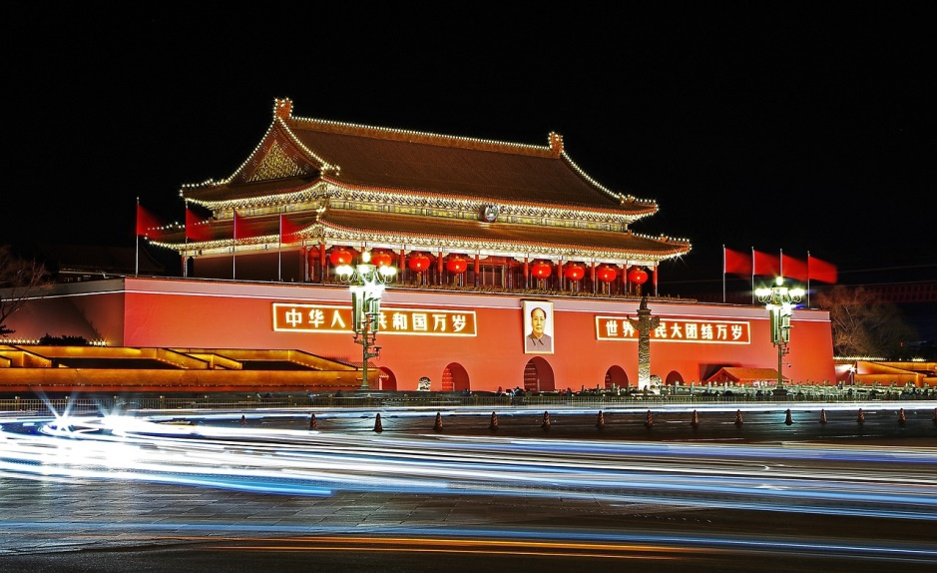
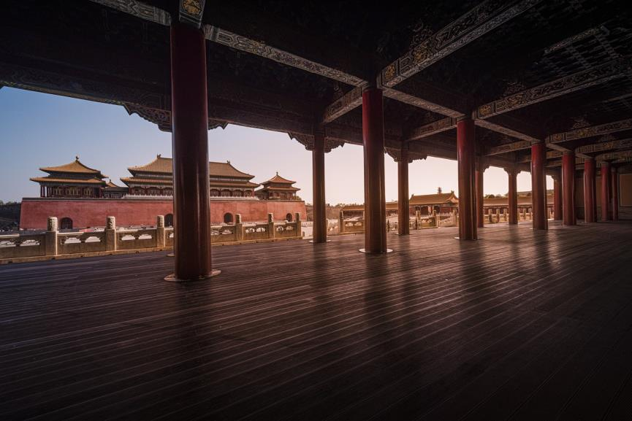
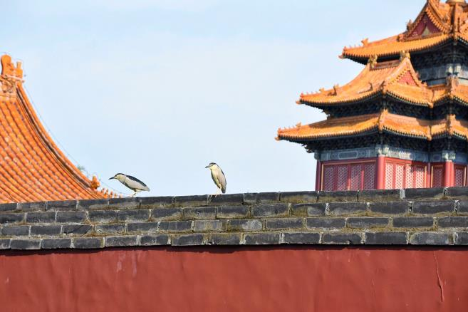
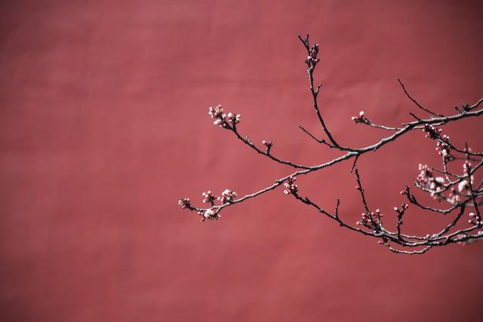
Tiananmen Gate
Clear wind, fallen leaves, branches
Ancient roads, red walls, yellow tiles
The beauty of the Forbidden City is
quiet and deep
Every frame is worthy of appreciation
After going to Tiananmen Gate
There is No need to queue up for tickets
You can enter the Palace Museum directly.

Slide 7
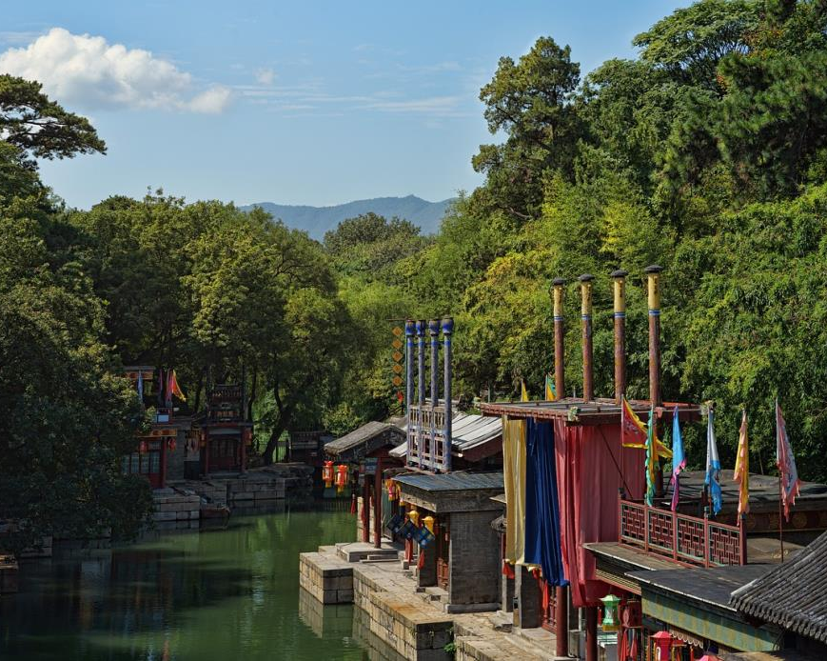
/Summer Palace
The Summer Palace is a large-scale landscape garden based on Kunming Lake and Longevity Hill, with the West Lake of Hangzhou as the blueprint, and drawing on the design techniques of gardens in the south of the Yangtze River.
It is also the most complete imperial palace and imperial garden preserved, known as the "Royal Garden Museum of China".

Slide 8
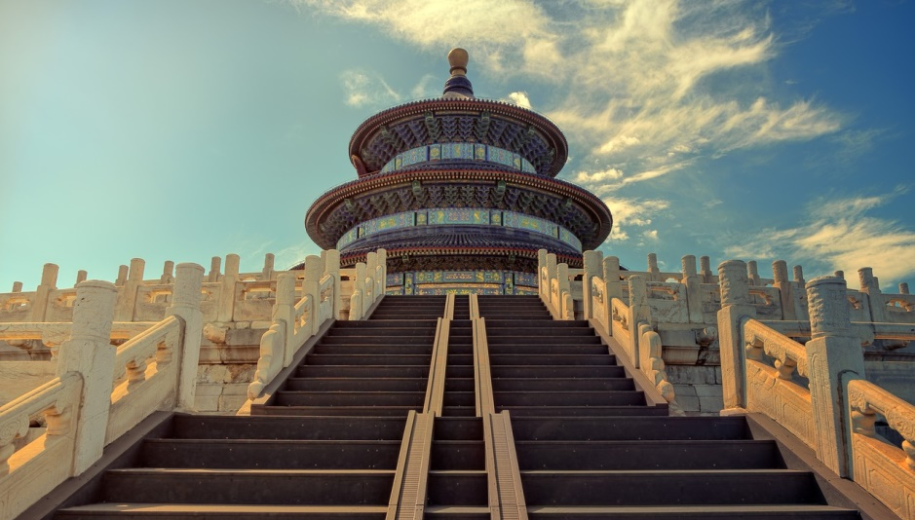
/Temple of Heaven
The Temple of Heaven is a worthwhile visiting place in Beijing. It is much bigger than the Forbidden City and smaller than the Summer Palace with an area of about 2,700,000 square meters.
It was built in 1420 A.D. during the Ming Dynasty to offer sacrifice to Heaven. As Chinese emperors called themselves ' The Son of Heaven', they dared not to build their own dweling,' Forbidden City' bigger than a dwelling for Heaven.
An interesting and famous place for you to visit here is called Echo Wall owning special feature.
The wall encloses Imperial Heavenly Vault. Its perimeter is 193 meters.
If you and your friend stand at the east and the west roots of the wall respectively and you whisper a word, then your friend will hear clearly what you said, isn’t it interesting? The phenomenon utilizes the theory of sound wave.

Slide 9
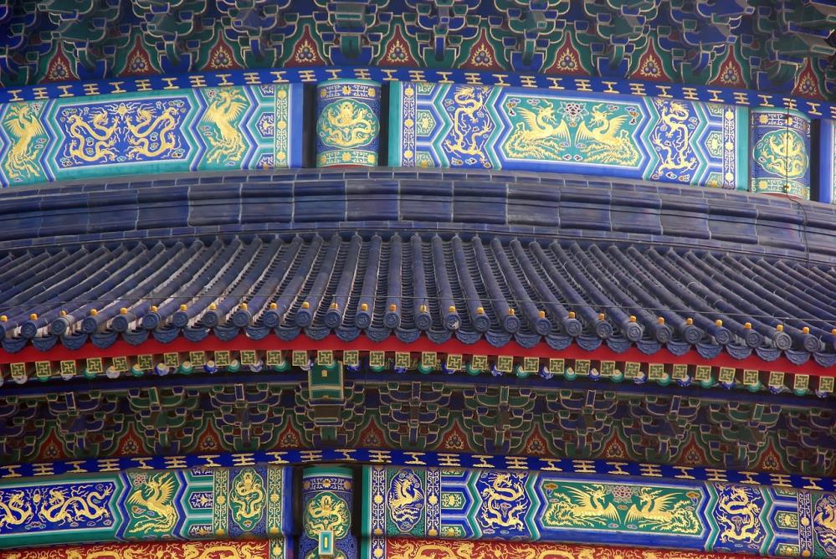
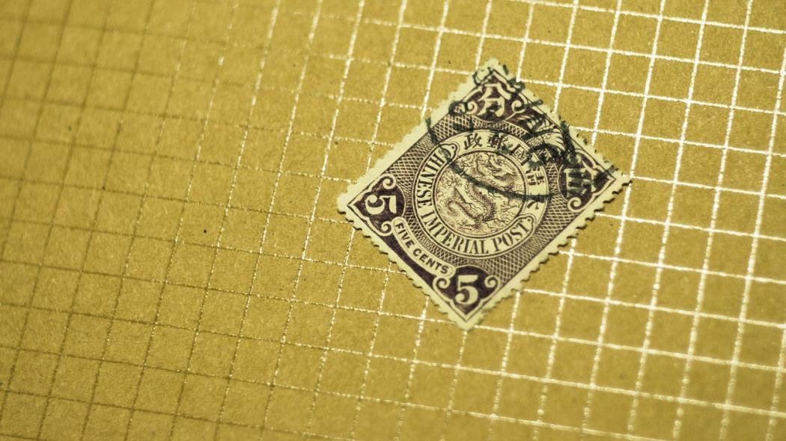
With a history of nearly 600 years,
this is the largest and most perfect
ancient heavenly worship complex in the world.
In the Ming and Qing Dynasties,
it was the place
where emperors worshipped the heaven.
It is also
the nearest place to "heaven"
in the hearts of the common people.
Many secrets and legends hidden here...

Slide 10
Get in Touch
H.T. CHINA - SHANGHAI HAN TANG TOUR
上海瀚唐国际旅游有限公司
T: +86 21 6333 1311
RVS@htc-tour.com
(English/Spanish Speaking)

